Slide 1


The Arc of Katy Membership Meeting
September 15, 2020

Slide 2
The Arc of Katy
2020 Membership Meeting
September 15, 2020
7:00 pm – 8:30 pm
AGENDA
Call to Order and Welcome Fred Shafer, President
Prayer Amy Campbell, Board Member
Approval of Minutes Fred Shafer, President
Approval of Board of Directors Terms of Office Ida Faye Elder, Board Development Co-chair
Approval of the Amended The Arc of Katy Fred Shafer, President
Bylaws
Increase of Minimum Membership Dues Fred Shafer, President
“30 Years of a Legacy of Service” Fred Shafer, President
The State of The Arc of Katy
2020-2021 The Arc of Katy Budget and Michael Lattal, Treasure
Financial Forecast
The Arc of Katy 2020-2023 Strategic Plan Fred Shafer, President
Adjournment of Meeting Fred Shafer, President

Slide 3
Executive – Election every 2 years | 2016 | 2017 | 2018 | 2019 | 2020 | 2021 | 2022
Shafer, Fred President |  | August | January |  | September | September
Duddridge, Cherie President Elect |  |  |  |  | February | September
Lattal, Mike Treasurer |  |  | September |  | September |  | September
Candito, Ellen Secretary |  |  |  |  | September |  | September
Board Members – Election every 3 years in September at General Meeting
Bode, Donna |  |  | September |  |  | September
Campbell, Amy | May |  |  | September |  |  | September
Candito, Ellen | May |  |  | September |  |  | September
Dahl, Fran |  |  | February |  |  | September
Doucette, Pat |  |  | August |  |  | September
Duddridge, Cherie |  | December |  |  | September |  | September
Elder, Don |  | May |  |  | September |  | September
Elder, Ida Faye |  | May |  |  | September |  | September
Jarvis, Amber |  |  |  | July |  | September
Kares, Carolyn |  | May |  |  | September |  | September
Kiblawi, Krista |  |  |  | July |  | September
Lattal, Mike |  |  | September |  |  | September
Laney, Margaret |  |  | September |  |  | September
McGovern, Mary |  |  |  | June |  | September
Peters, Marchelle |  |  | January |  |  | September
Shafer, Fred |  | June |  |  | September |  | September

Slide 4
Approved by the Board of Directors to increase the minimum membership dues for individuals and families from $50 a year to $75 a year for

Slide 5
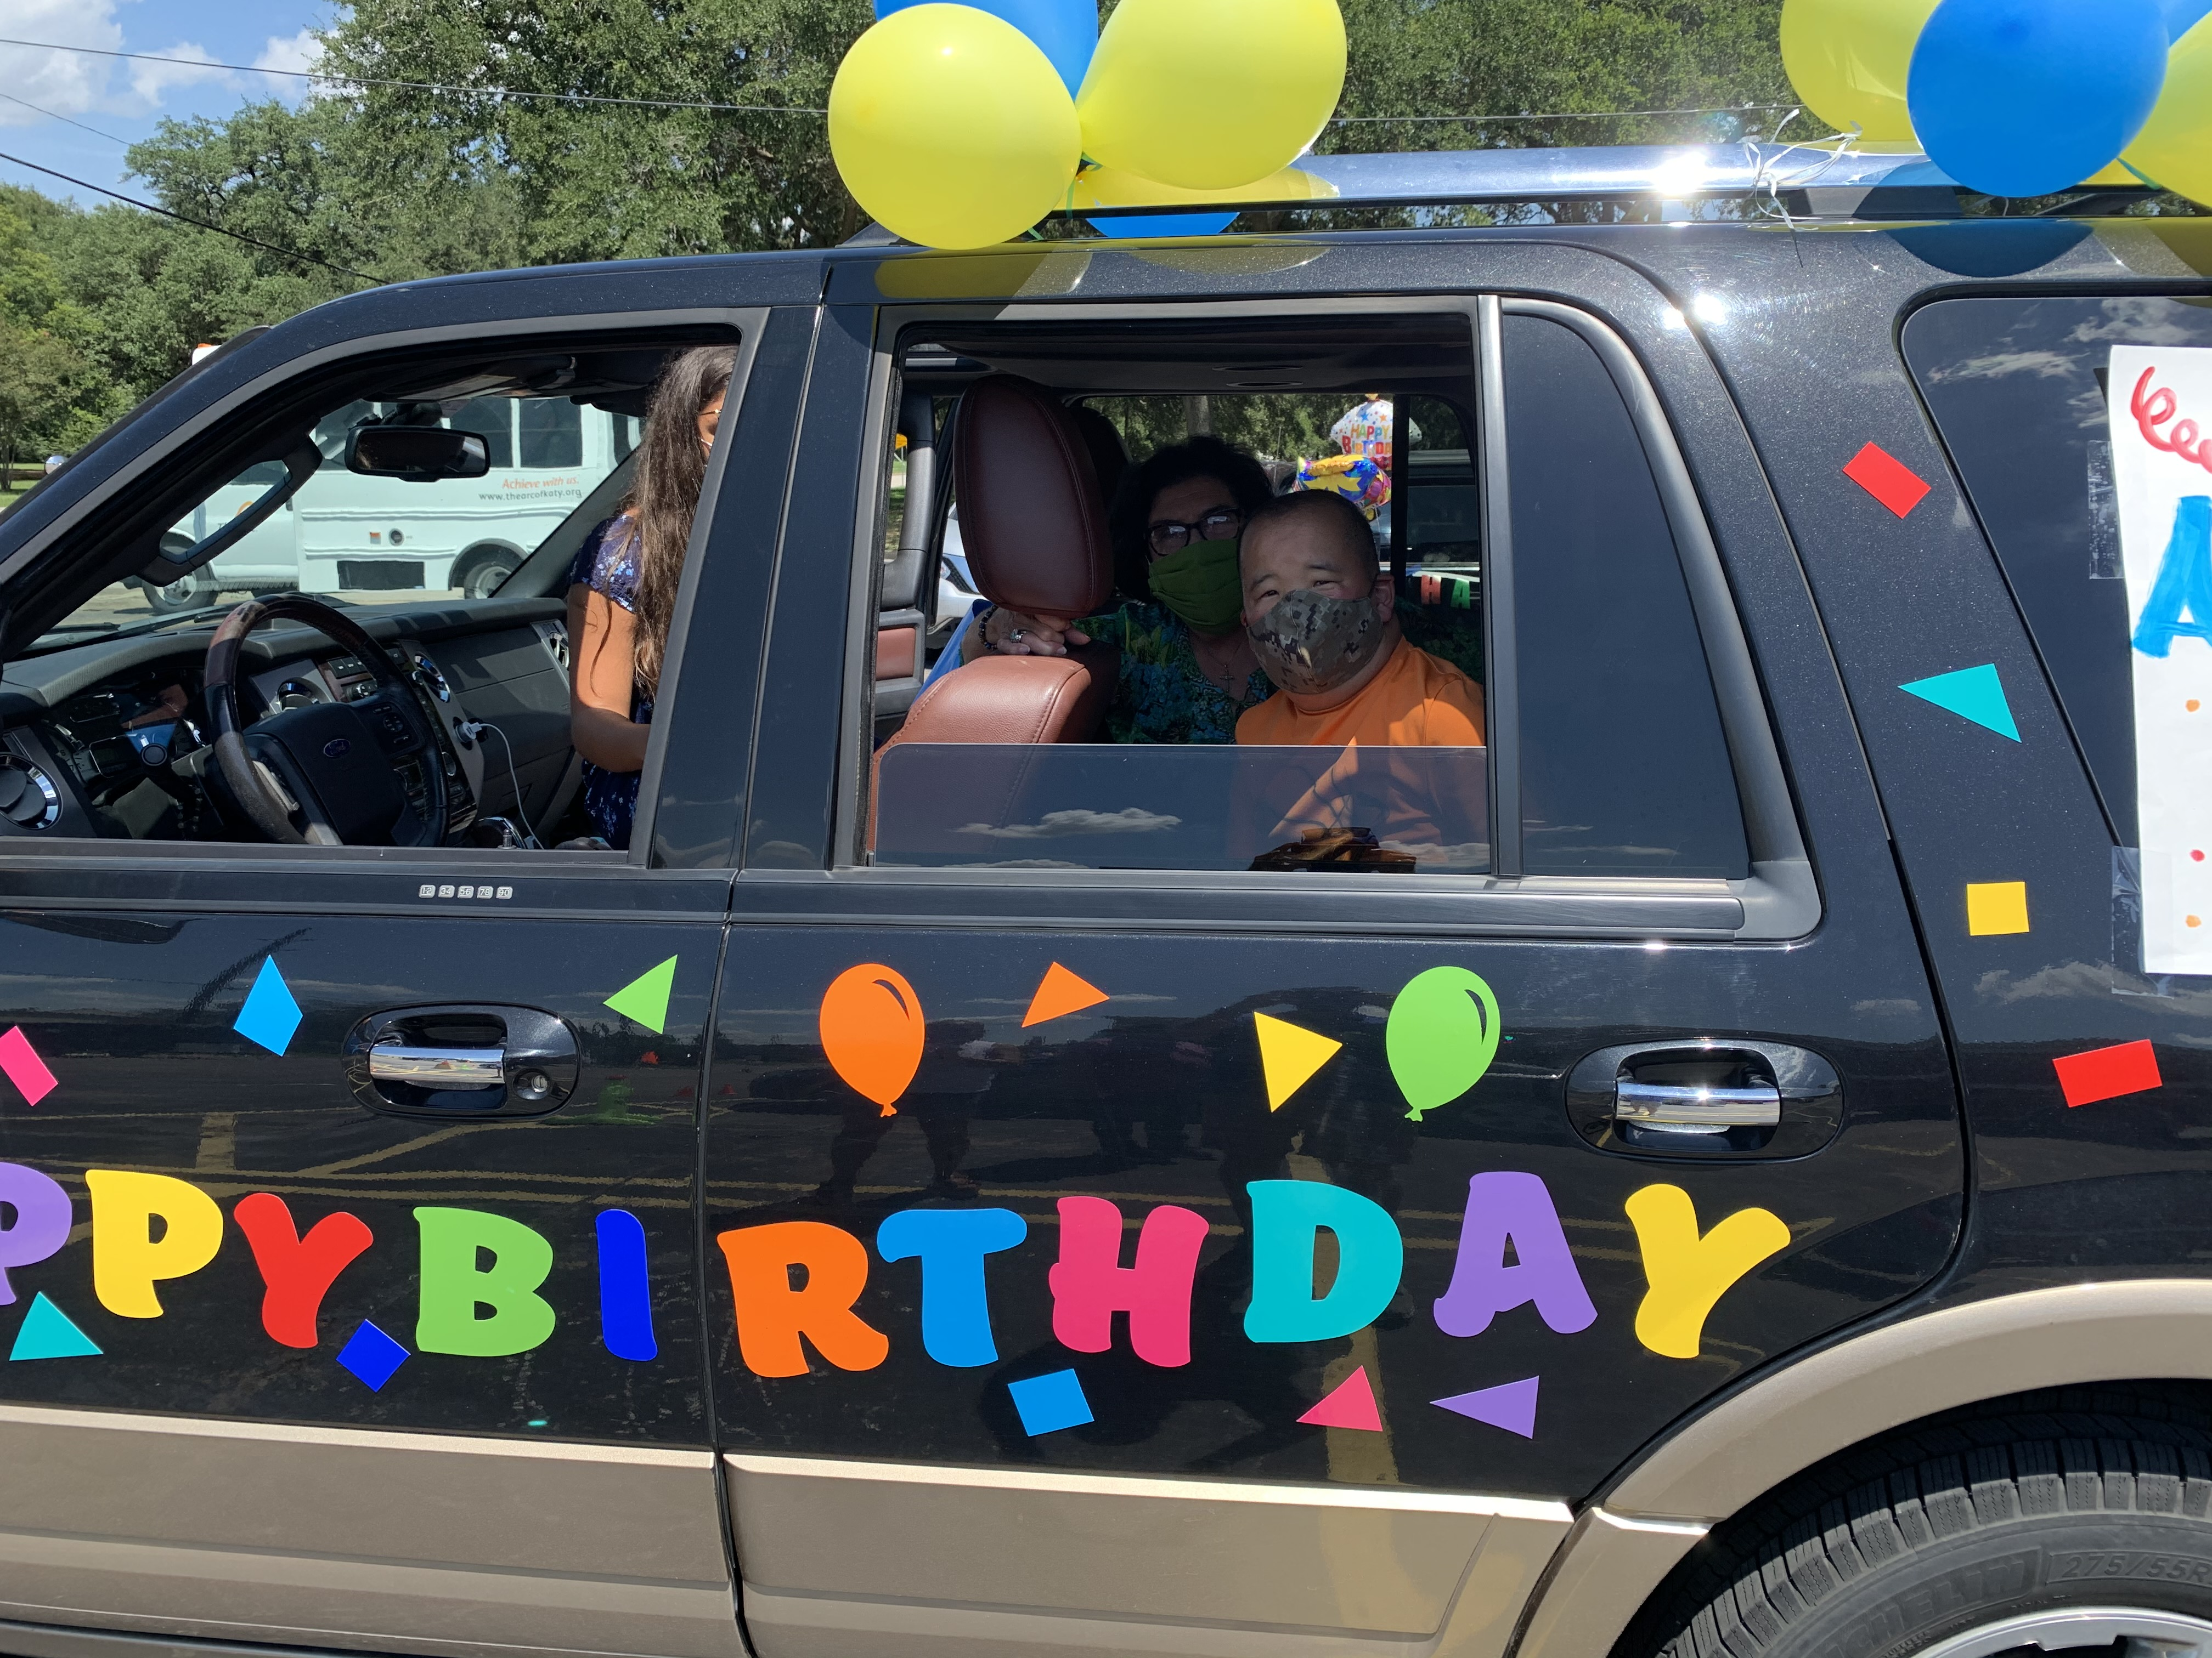
“30 Years of a Legacy of Service”

Slide 6
30 Years of a Legacy of Service
“ Being inspired by a personal vision of the future gives fuel to the present moment”
Mike Van Hoozer

Slide 7
The Arc of Katy Board of Directors
Fred Shafer, President
Cherie Duddrige, President Elect
Mike Lattal, Treasure
Ellen Candito, Secretary
Don Elder
Ida Faye Elder
Margaret Laney
Amy Campbell, Charter Member
Carolyn Kares
Mary McGovern
Pat Doucette
Amber Jarvis
Fran Dahl
Krista Kiblawi
Marchelle Peters
Donna Bode

Slide 8
The Arc of Katy
Day Program
Staff
Sandi Dancel, Program Coordinator
Therese Lattal, Be Strong Program
Rhonda Johnstone, Be Strong Program
Barbara Kosciewicz
Travis Beck
Steve Laney
Renee Johnson
Marilyn Smythe
Willie Johnson
Christine Clark
Ann Ferner, Administrative Assistant

Slide 9
“When you cannot control what’s happening, challenge yourself to control the way you respond to what’s happening”

Slide 10
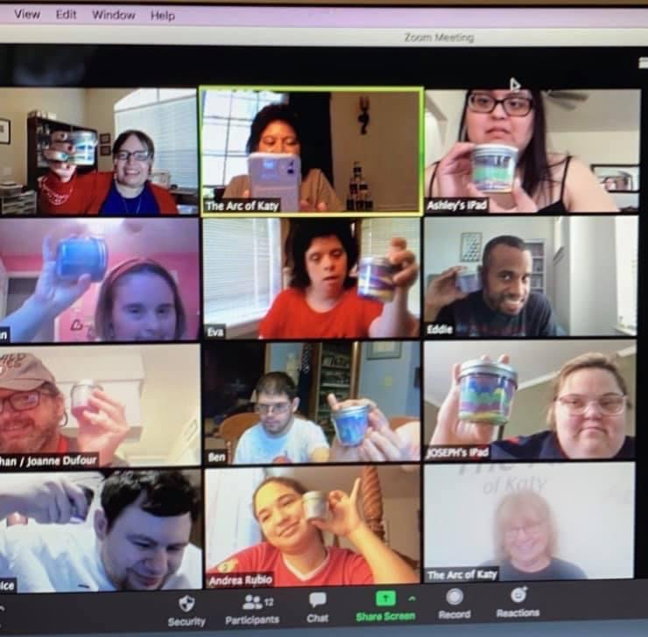
Meeting the Challenge of the COVID 19 Global Pandemic

Slide 11
Meeting the Challenge of the COVID 19 Global Pandemic
COVID 19 Response Core Team
  Established Health and Safety Measures
  Staff Training
Payroll Protection Plan
Virtual Day Program and Socials
Strategic Budget Planning
Cost Cutting Opportunities
  Workers Compensation Premium Reimbursement ($2,282)
  Auto Insurance Layup Credit ($8,994)

Slide 12
Advocating for Individuals with IDD and their Families

Slide 13
Active Participation in:
  The Arc of Texas Annual Meeting
  The Arc of Texas State Chapter Meeting
  The Arc of Texas State Chapter Board President Meetings

Slide 14
Advocating for Greater Flexibility of Medicaid HCS Funds
Texas Health and Human Services:
  Does not allow for HCS Funds for virtual based services (i.e. Zoom)
  HCS Funds are used in other states for virtual services
Participated in state Arc Chapter meeting with Representative James Frank, Chair of the Human Services Committee
Sent letter to Senator Lois Kolkhorst, Chair of Senate Committee on Health and Human Services
The Arc of Katy will be requesting letters of testimony on the benefits of virtual programs.

Slide 15
2020-2023
The Arc of Katy
Strategic Plan
Our Mission: To provide opportunities for individuals with intellectual and developmental disabilities that enable each person to be included as a respected and active member of the community throughout their lifetime.
Goal 1: Employ an Executive Director to provide leadership that supports the vision, mission and overall operation of the organization
Goal 2: Develop a Comprehensive Fund Development Plan for fund development, management and sustainability to support the organization’s vision and mission.

Slide 16
2020-2023
The Arc of Katy
Strategic Plan
Goal 3: Establish a volunteer program that engages community members in the programs and services of the organization and serve as an ambassador and advocate for individuals with intellectual and developmental disabilities.
Goal 4: Expand and enhance the Board of Directors to serve as the governing body to ensure sound, ethical, legal and financial management policies that support the vision and mission of the organization.
Goal 5: Increase and expand program and services to individuals with intellectual and developmental disabilities in Katy and surrounding communities.

Slide 17
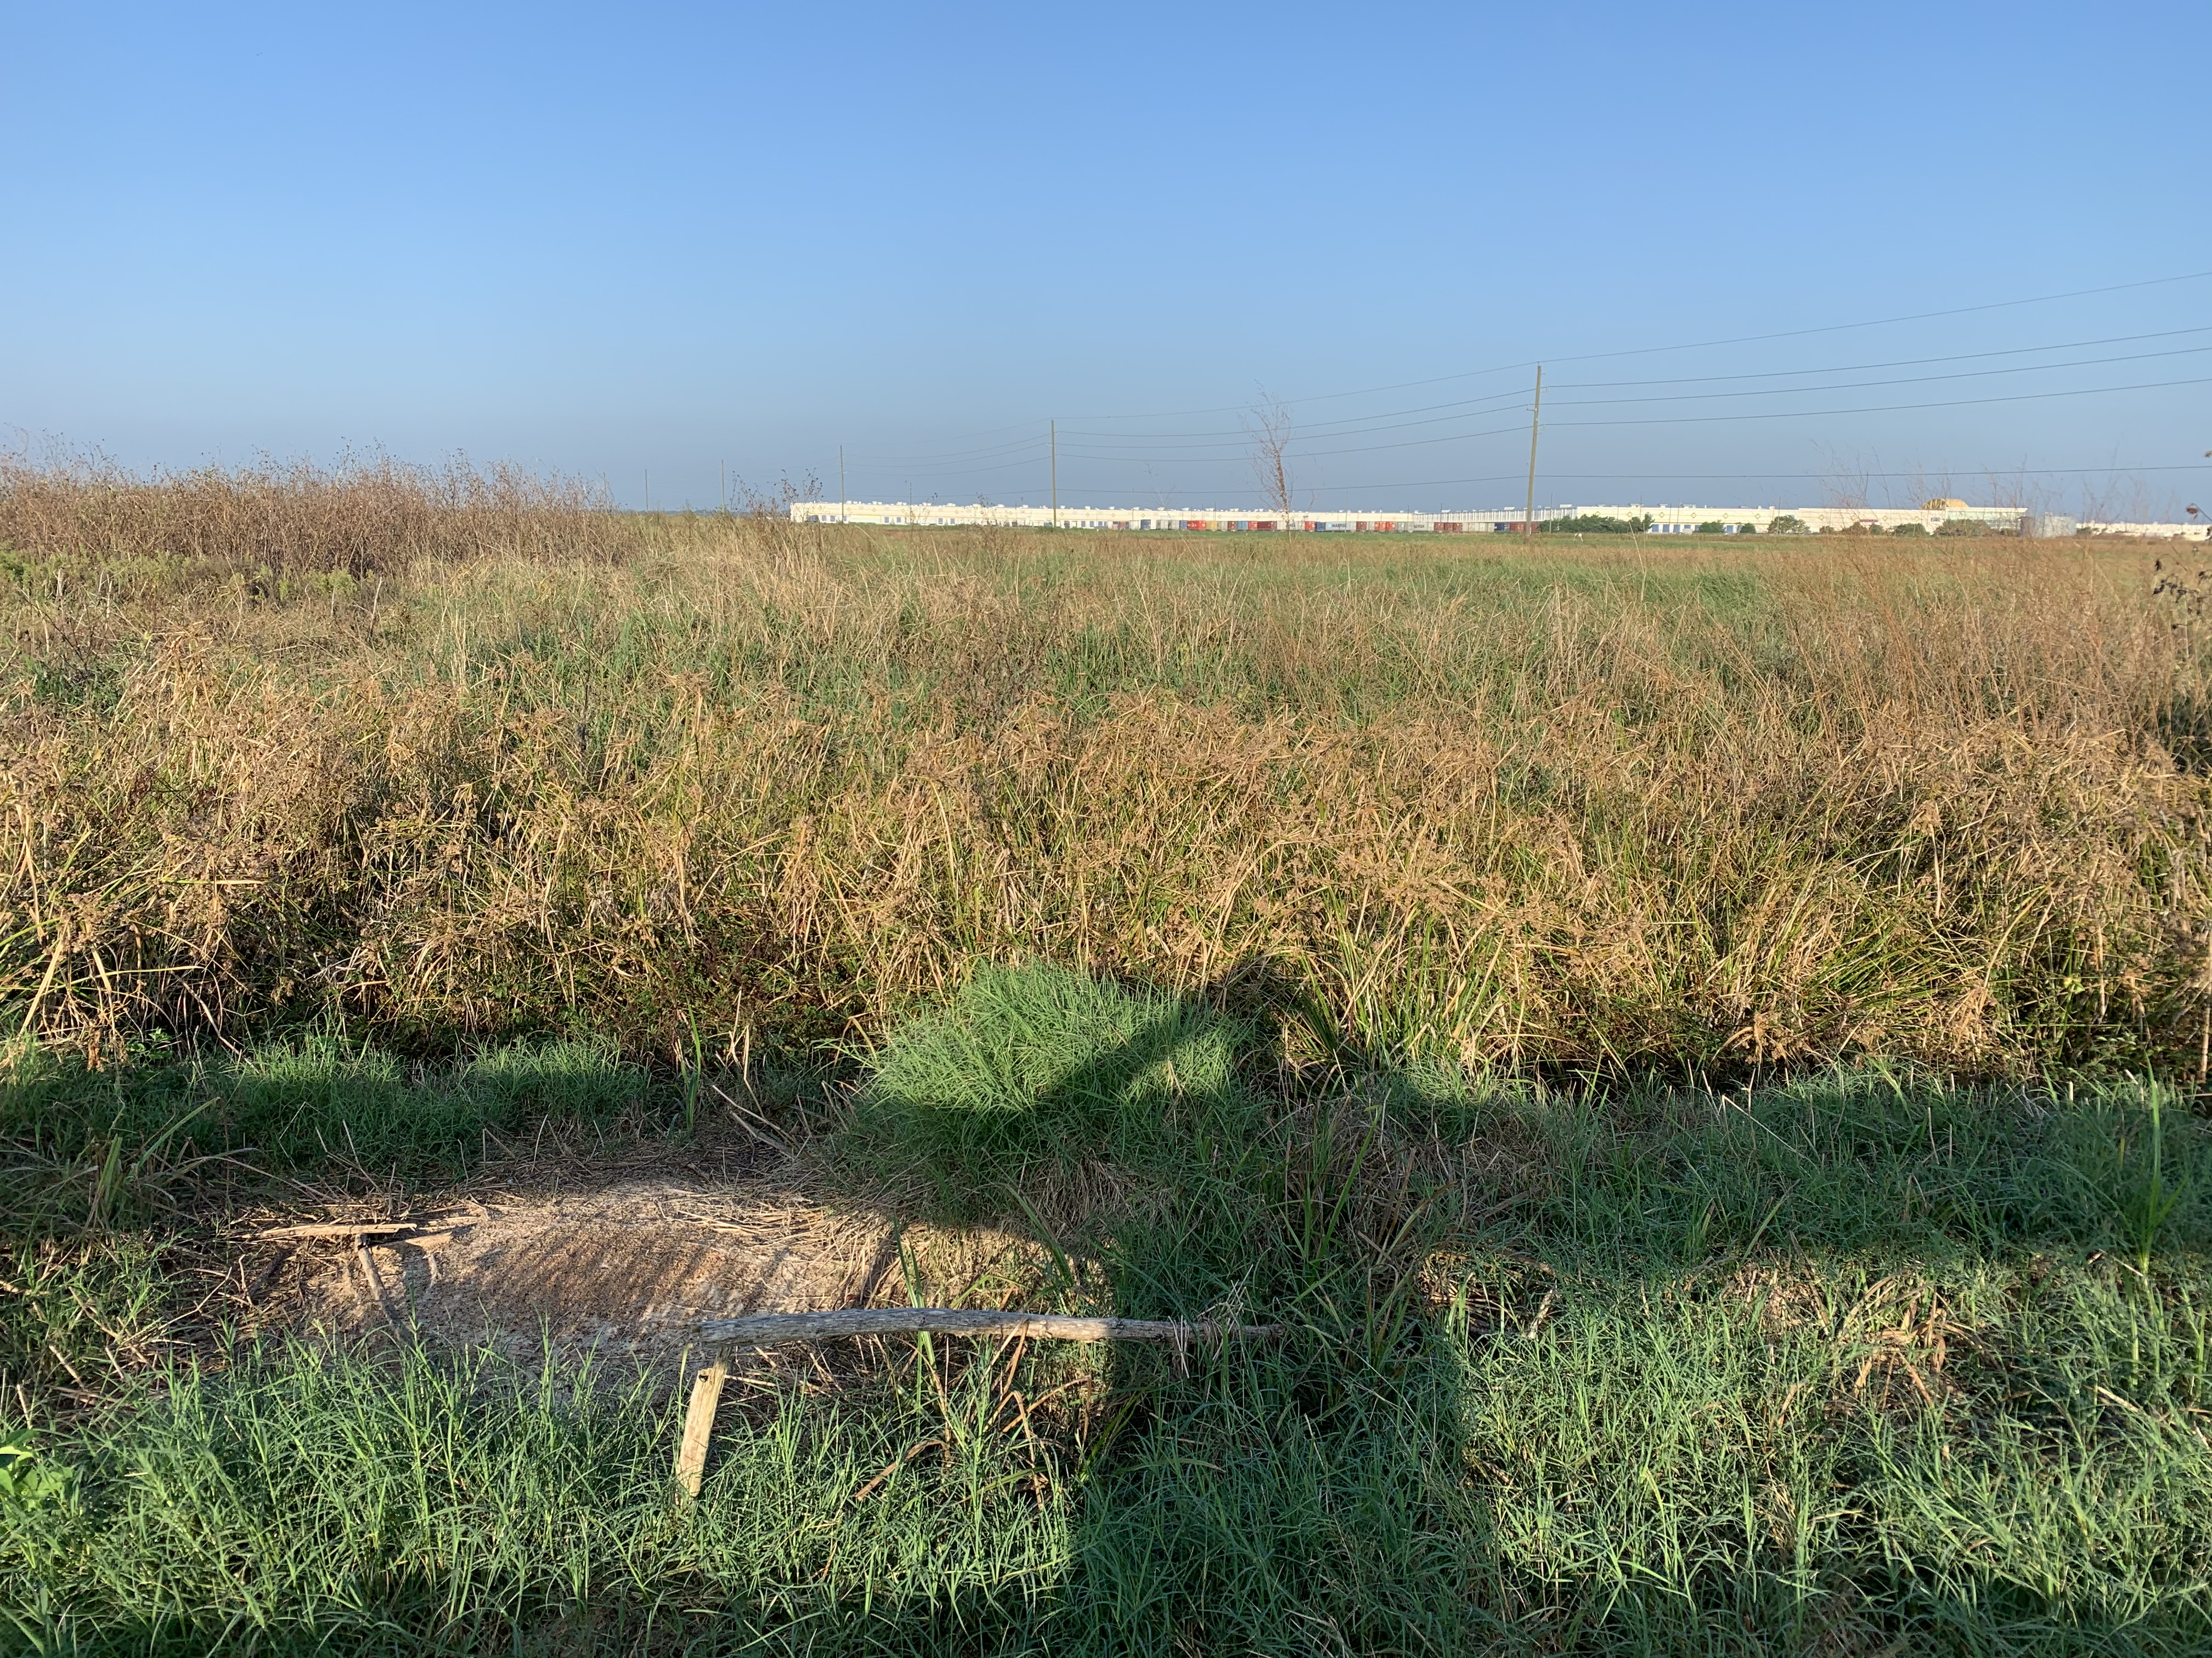
Potential New Location for The Arc of Katy.
I will insert a picture of Jordan Road location.

Slide 18
The Arc of Katy
2019-2020 Financials
2020-2021 Budget

Slide 19
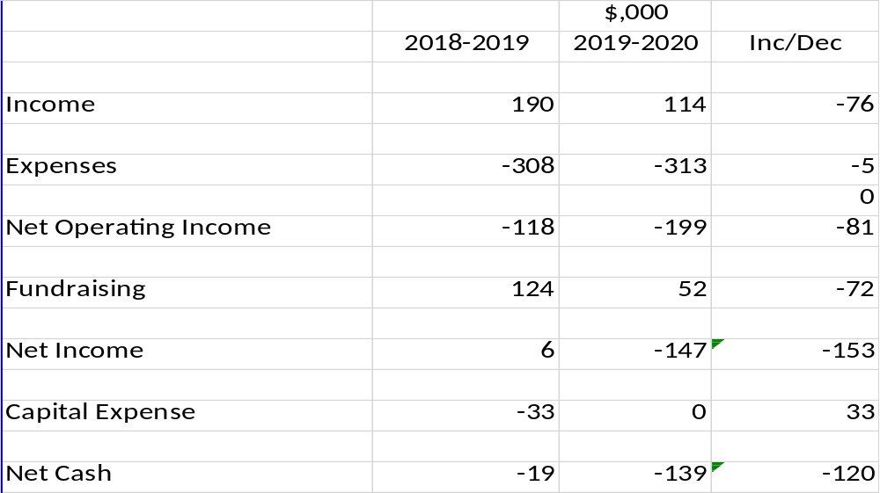
Summary – Highlights 2019-2020
Reduced income due to COVID Shutdown
Higher expenses, rent and insurance
Reduced fundraising gala deferred
Bus purchased in 2019
Impact of COVID and shutdown had significant financial impact on The Arc of Katy this last fiscal year

Slide 20
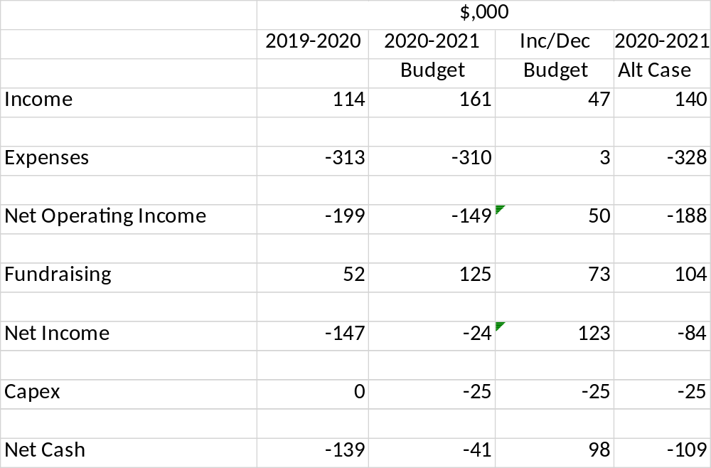
2020-2021 Budget
Budget- Virtual through October, Nov-Feb Reduced capacity full March-Aug
Alt Case Virtual through December reduced Capacity through May full June-Aug ,higher rent
Need significant increase in fundraising i.e. gala
If COVID extends through next year could see alternative case

Slide 21
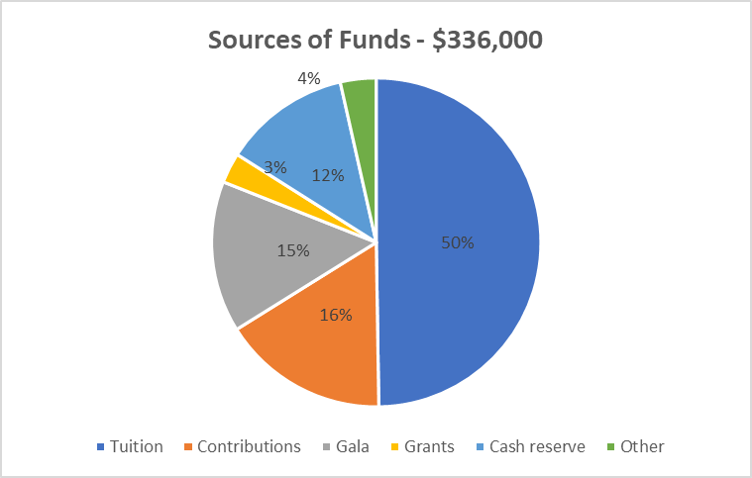
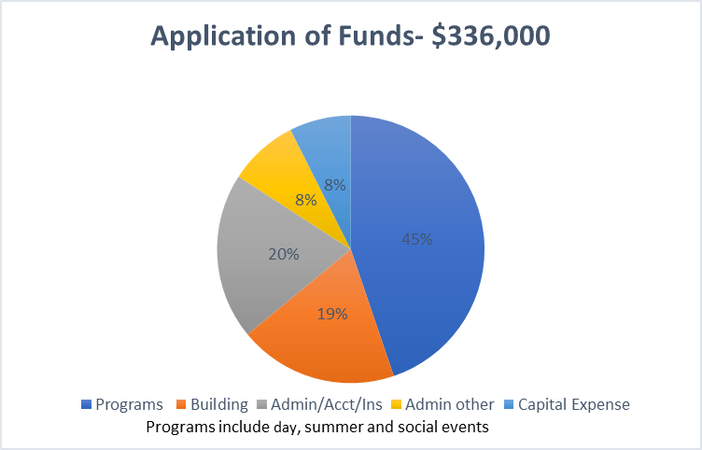
Source and Application of Funds 2020-2021

Slide 22
Questions and Answers

